Slide 1
Countries of the World
December 24, 2018

Slide 2
Data

Slide 3
Data mining
AI (Artificial Intelligence)
IA (Intelligence-Assisted) + ??
Design
Manufacturing
Marketing
IoT
…

Slide 4
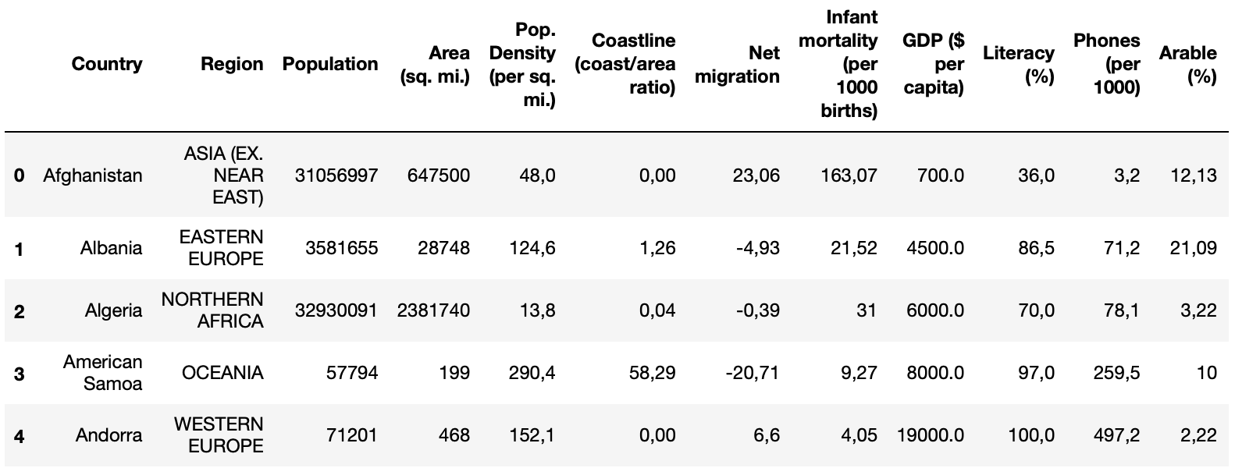
Dataset: 227 countries, 20 features
Country names linked to region, population, area size, GDP, mortality and more
countries of the world.csv (37.41 KB): Data compiled from US Government (1970-2017)
https://www.kaggle.com/fernandol/countries-of-the-world

Slide 5
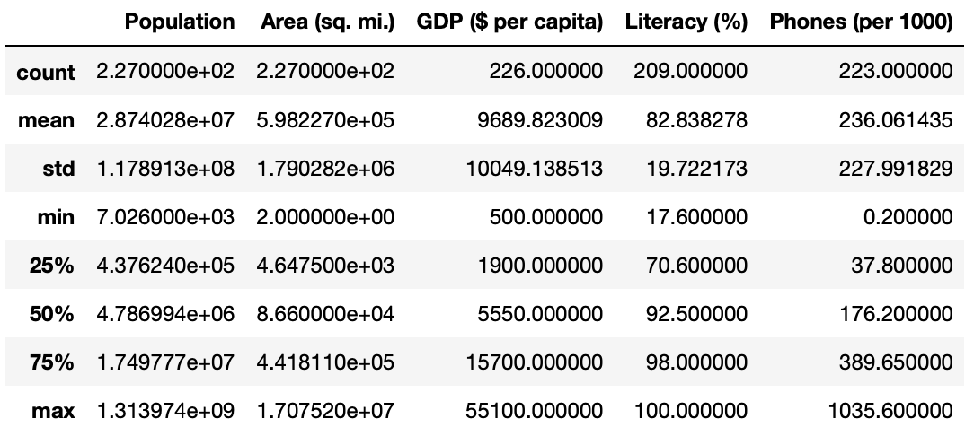
Observation on phone penetration

Slide 6
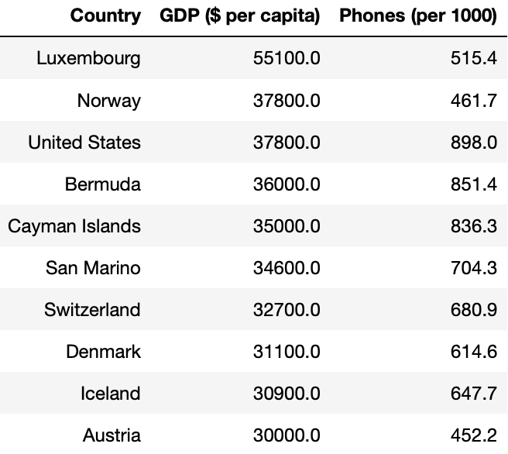
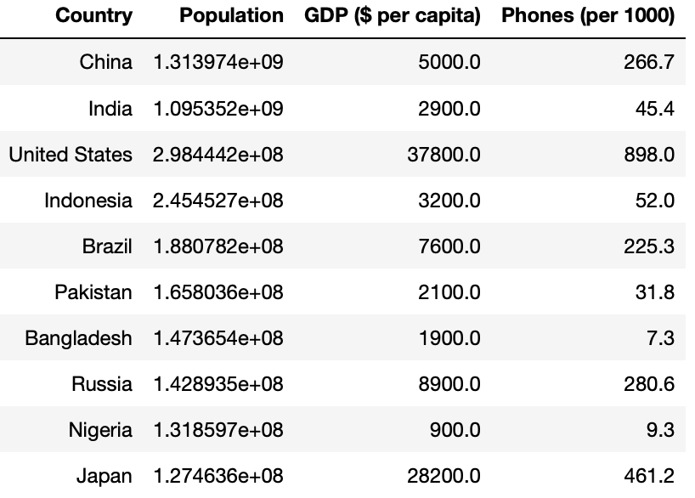
Top-10 from different perspectives

Slide 7
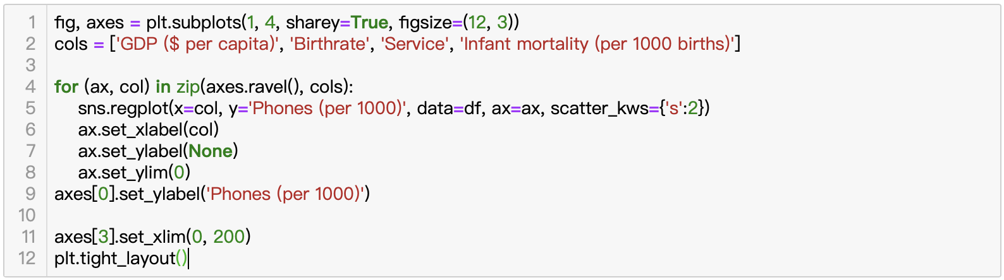
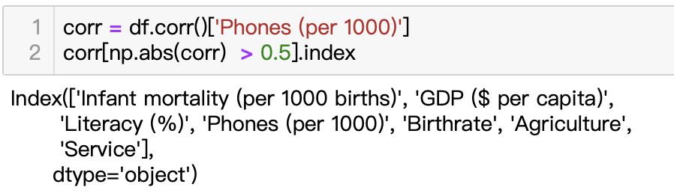
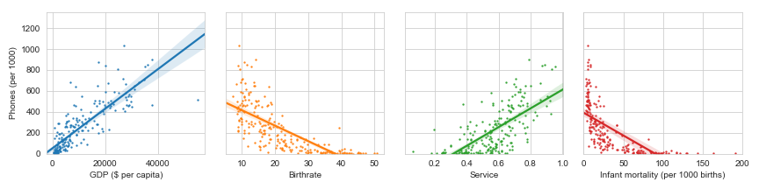
What features affect phone penetration?

Slide 8
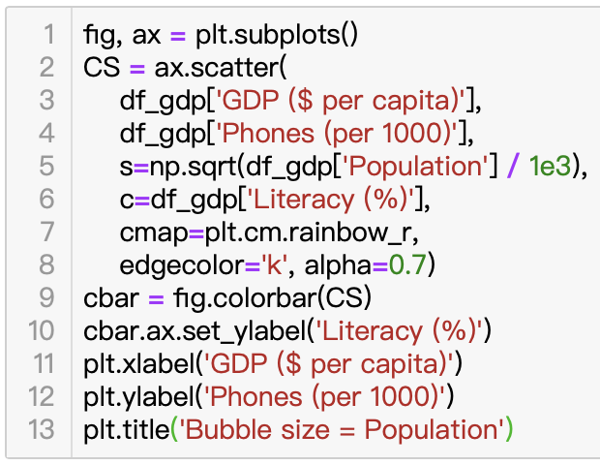
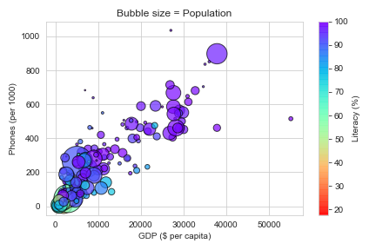
What features affect phone penetration?
Top-3 positively correlated features
GDP ($ per capita) 0.83
Service 0.68
Literacy (%) 0.60
Top-3 negatively correlated features
Birthrate -0.72
Infant mortality (per 1000 births) -0.67
Agriculture -0.60

Slide 9
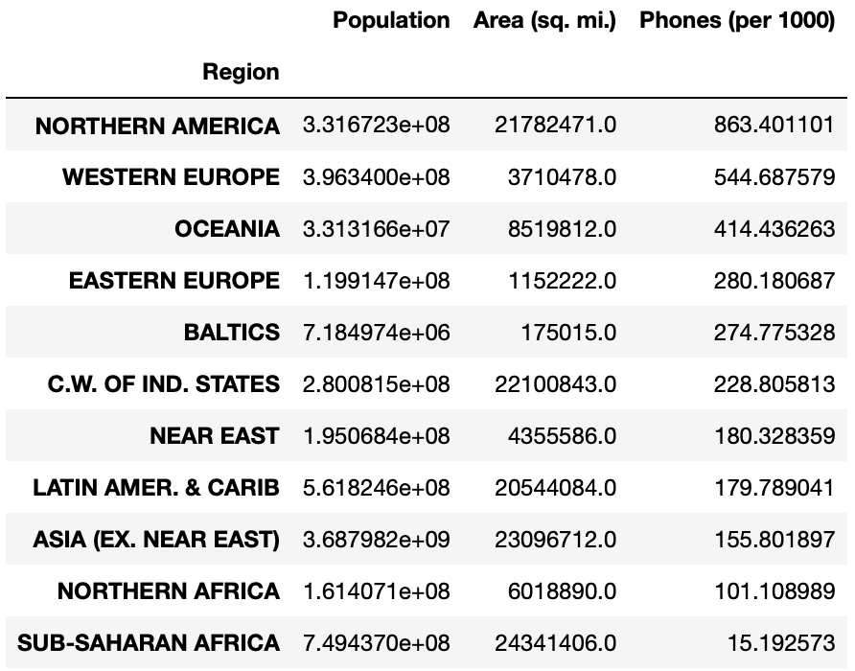
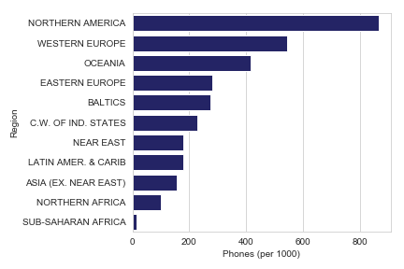
pandas.DataFrame.groupby(‘Region’)

Slide 10
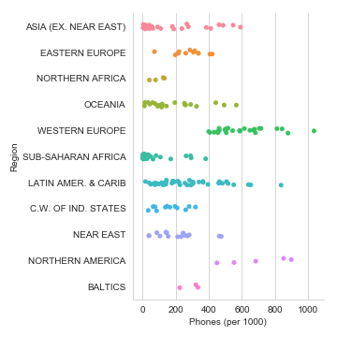
sns.catplot()

